Slide 1
Chapter 11 Fractional-N Synthesizers
11.1 Basic Concepts
11.2 Randomization and Noise Shaping
11.3 Quantization Noise Reduction Techniques
11.4 Appendix I: Spectrum of Quantization Noise
Behzad Razavi, RF Microelectronics.
Prepared by Bo Wen, UCLA

Slide 2
Chapter Outline
Randomization and
Noise Shaping
Quantization Noise
Reduction
Modulus Randomization
Basic Noise Shaping
Higher-Order Noise Shaping
Out-of-Band Noise
Charge Pump Mismatch
DAC Feedforward
Fractional Divider
Reference Doubling
Multi-Phase Division

Slide 3
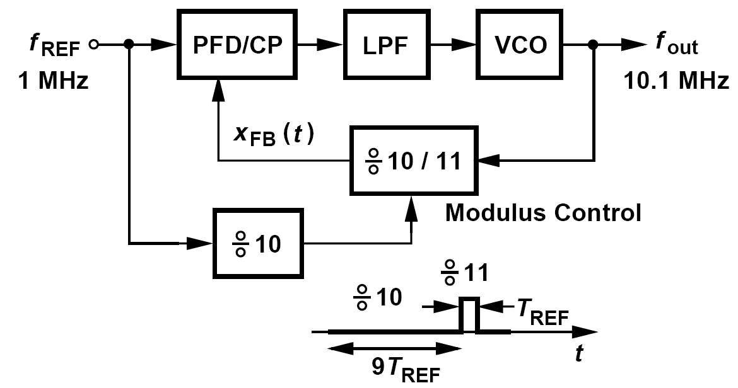
Basic Concepts: Example of Fractional-N Loop
We expect to obtain other fractional ratios between N and N+1 by simply changing the percentage of the time during which the divider divides by N or N+1
In addition to a wider loop bandwidth than that of integer-N architectures, this approach also reduces the inband “amplification” of the reference phase noise because it requires a smaller N.

Slide 4
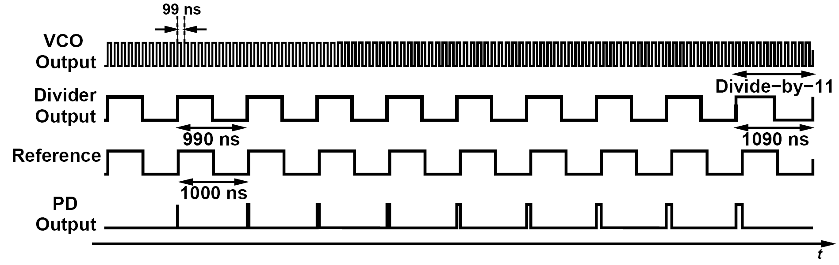
Fraction Spurs
In above example, VCO is modulated at a rate of 0.1MHz and producing sidebands at ±0.1MHz×n around 10.1MHz, where n denotes the harmonic number. These sidebands are called fractional spurs.
For a nominal output frequency of (N+α)f_{REF}, the LPF output exhibits a repetitive waveform with a period of 1/(αf_{REF})

Slide 5
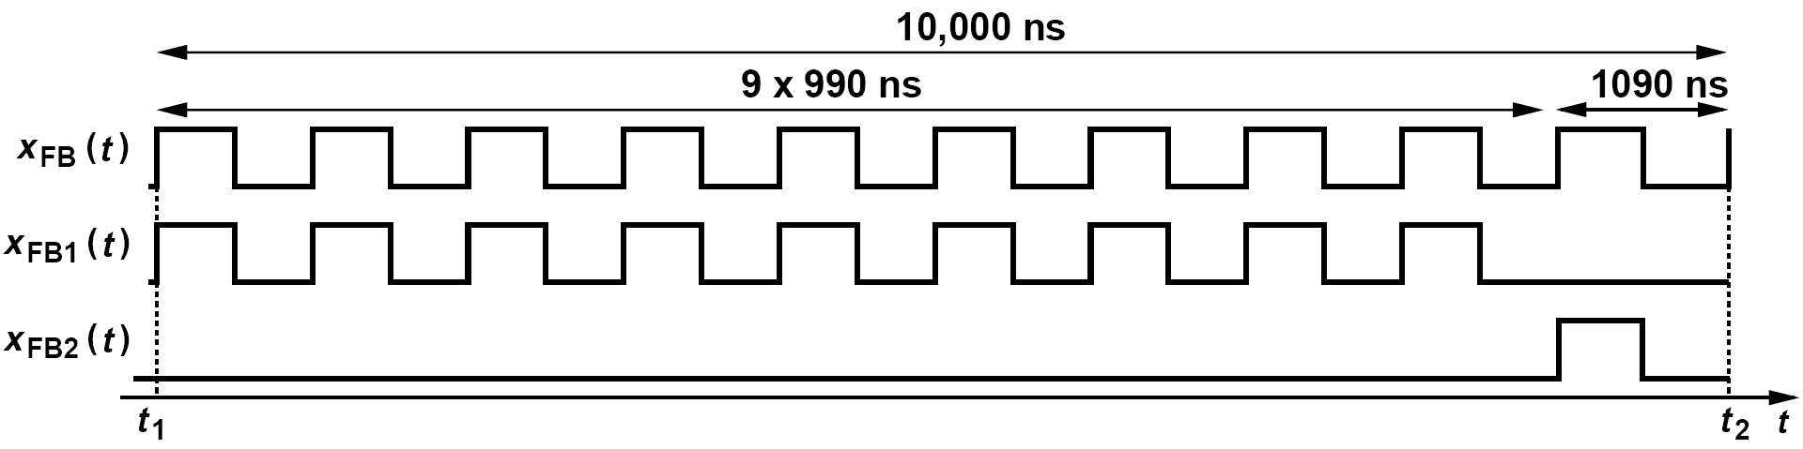
Fraction Spurs: Another Perspective
The overall feedback signal, x_{FB}(t) can be written as the sum of two waveforms, each of which repeat every 10,000 ns. The first waveform consists of nine periods of 990 ns and a “dead” time of 1090 ns, while the second is simply a pulse of width 1090/2 ns. Since each waveform repeats every 10,000 ns, its Fourier series consists of only harmonics at 0.1 MHz, 0.2 MHz, etc.
The sidebands can be considered FM (and AM) components, leading to periodic phase modulation:

Slide 6
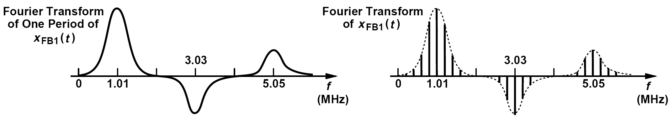
Example: Spectrum of Fractional Spur
Determine the spectrum of x_{FB1}(t) in figure below.
Solution:
Let us first find the Fourier transform of one period of the waveform (from t₁ to t₂). This waveform consists of nine 990-ns cycles. If we had an infinite number of such cycles, the Fourier transform would contain only harmonics of 1.01 MHz. With nine cycles, the energy is spread out of the impulses. If this waveform is repeated every 10 μs, its Fourier transform is multiplied by a train of impulses located at integer multiples of 0.1 MHz. The spectrum thus appears as shown in figure below.

Slide 7
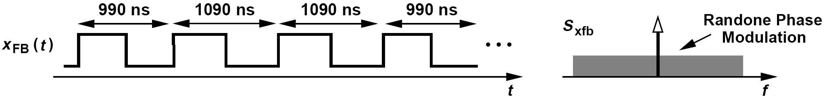
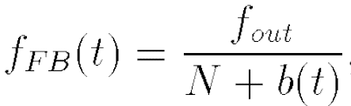

Randomization and Noise Shaping: Modulus Randomization
x_{FB}(t) exhibits a random sequence of 990-ns and 1090-ns periods
x_{FB}(t) now contains random phase modulation:
The modulus breaks the periodicity in the loop behavior, converting the deterministic sidebands to noise
The instantaneous frequency of the feedback signal is therefore expressed as:
where b(t) randomly assumes a value of 0 or 1 and has an average value of α
In terms of its mean and another random variable with a zero mean:

Slide 8
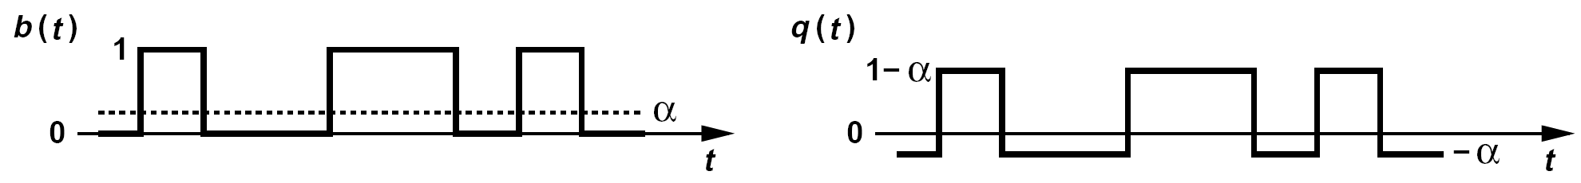
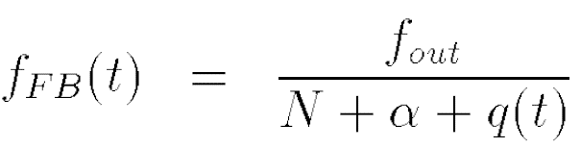
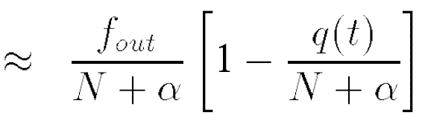
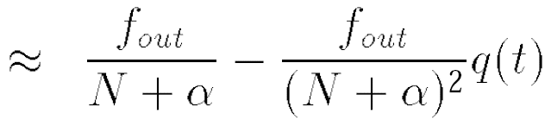
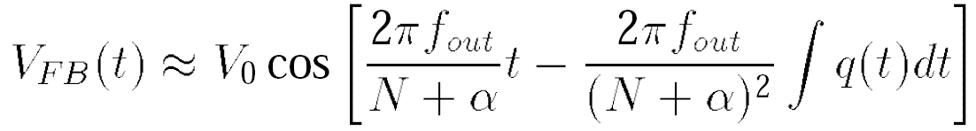
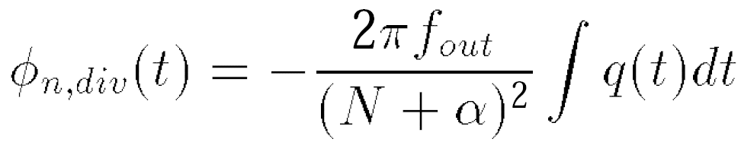
More about Randomization
Plot b(t) and q(t) as a function of time.
The sequence b(t) contains an occasional square pulse so that the average is α. Subtracting α from b(t) yields the noise waveform, q(t).
If q(t) << N + α, we have
The feedback waveform arriving at the PFD
Phase noise given by:

Slide 9
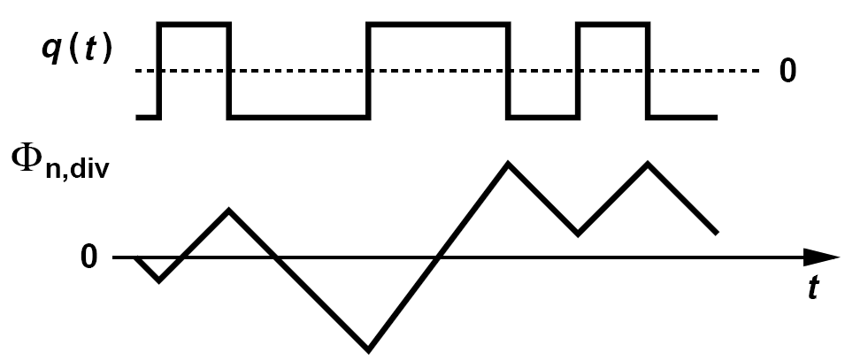
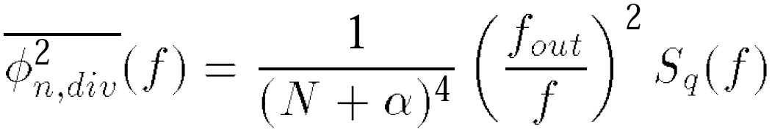
More Examples of Phase Noise
Plot the previous formulated phase noise a function of time.
With the aid of the wave form obtained last Example for q(t), we arrive at the random triangular waveform shown below:
Determine the spectrum of ϕ_{n,div}(t).
The time integral of a function leads to a factor of 1/s in the frequency domain. Thus, the power spectral density of q(t) must be multiplied by [2 π f_{out} / (N + α)2 / ω] 2,
where S_{q}(f) is the spectrum of the quantization noise, q(t). Note that this noise can be “referred” to the other PFD input—as if it existed in the reference waveform rather than the divider output.

Slide 10
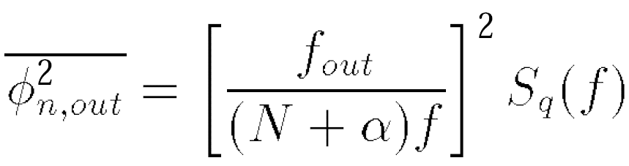
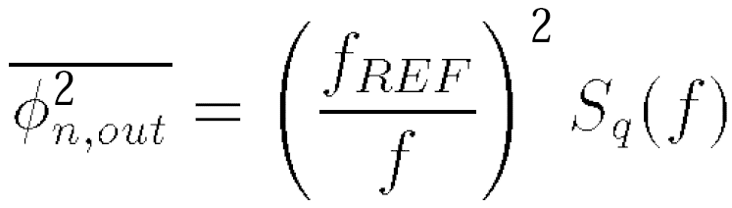
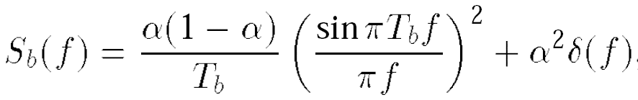
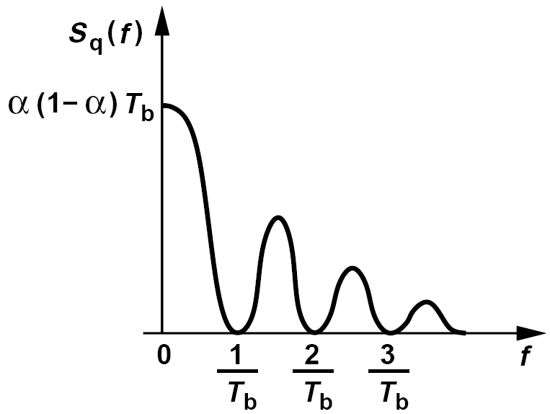
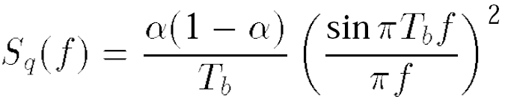
Synthesizer Output Phase Noise within the Loop Bandwidth
Alternatively, since f_{out} = (N+α)f_{REF}
Compute S_{q}(f) if b(t) consists of square pulses of width T_{b} that randomly repeat at a rate of 1/T_{b}
We first determine the spectrum of b(t), S_{b}(f). As shown in Appendix I, S_{b}(f) is given by:
where the second term signifies the dc content. Thus,
revealing a main “lobe” between f = 0 and f = 1/T_{b}

Slide 11
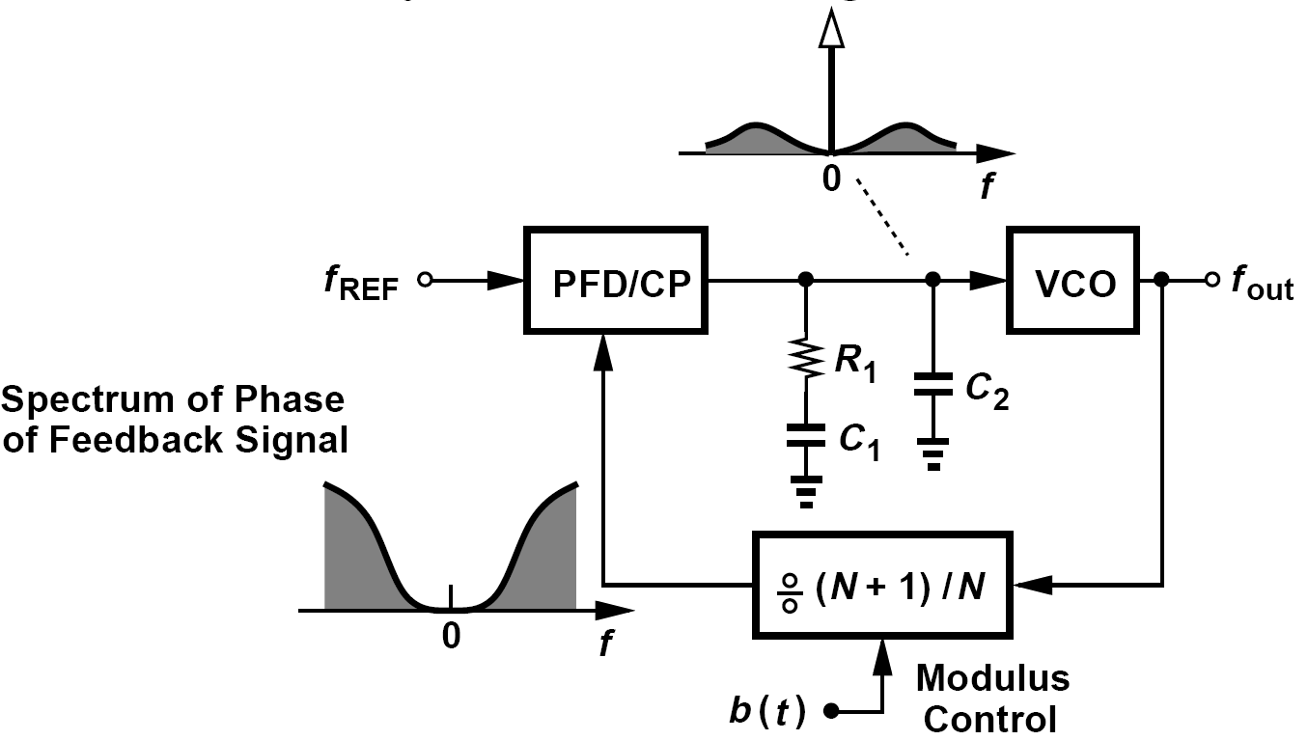
Basic Noise Shaping: Randomization Resulting in High-Pass Phase Noise Spectrum
We wish to generate a random binary sequence, b(t), that switches the divider modulus between N and N+1 such that (1) the average value of the sequence is α, and (2) the noise of the sequence exhibits a high-pass spectrum.

Slide 12
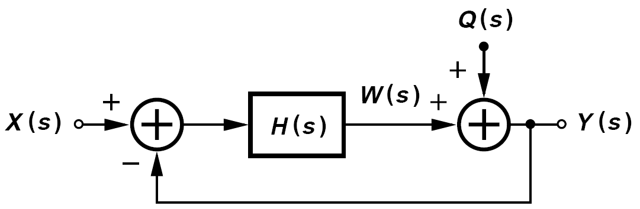
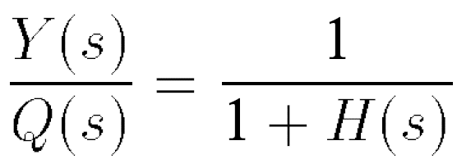
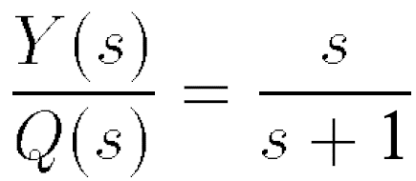
Negative Feedback System as a High-Pass System
If H(s) is an ideal integrator
A negative feedback loop containing an integrator acts as a high-pass system on the noise injected “near” the output. If Q varies slowly with time, then the loop gain is large, making W a close replica of Q and hence Y small.

Slide 13
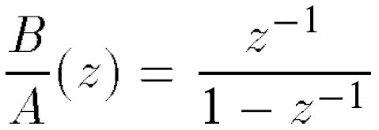
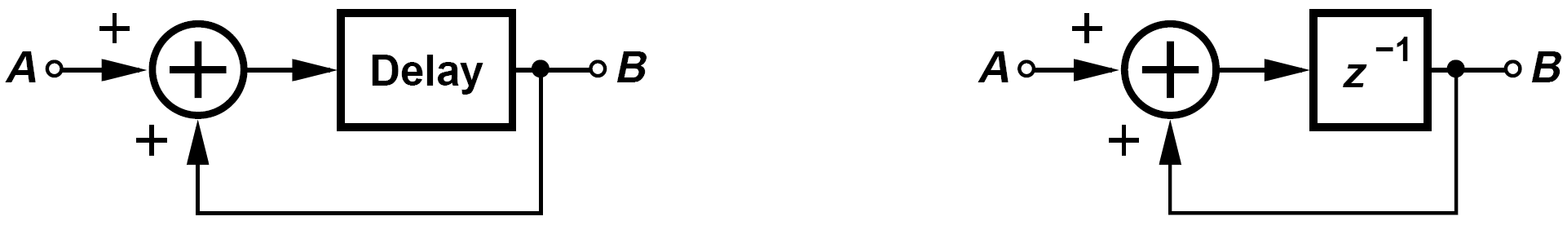
Example of a Discrete-Time Version of Previous System (Ⅰ)
Construct a discrete-time version of the system shown in the previous slide if H must operate as an integrator
Solution:
Discrete-time integration can be realized by delaying the signal and adding the result to itself. We observe that if, for example, A = 1, then the output continues to rise in unity increments in each clock cycle. Since the z-transform of a single-clock delay is equal to z-1, we draw the integrator as shown below and express the integrator transfer function as

Slide 14
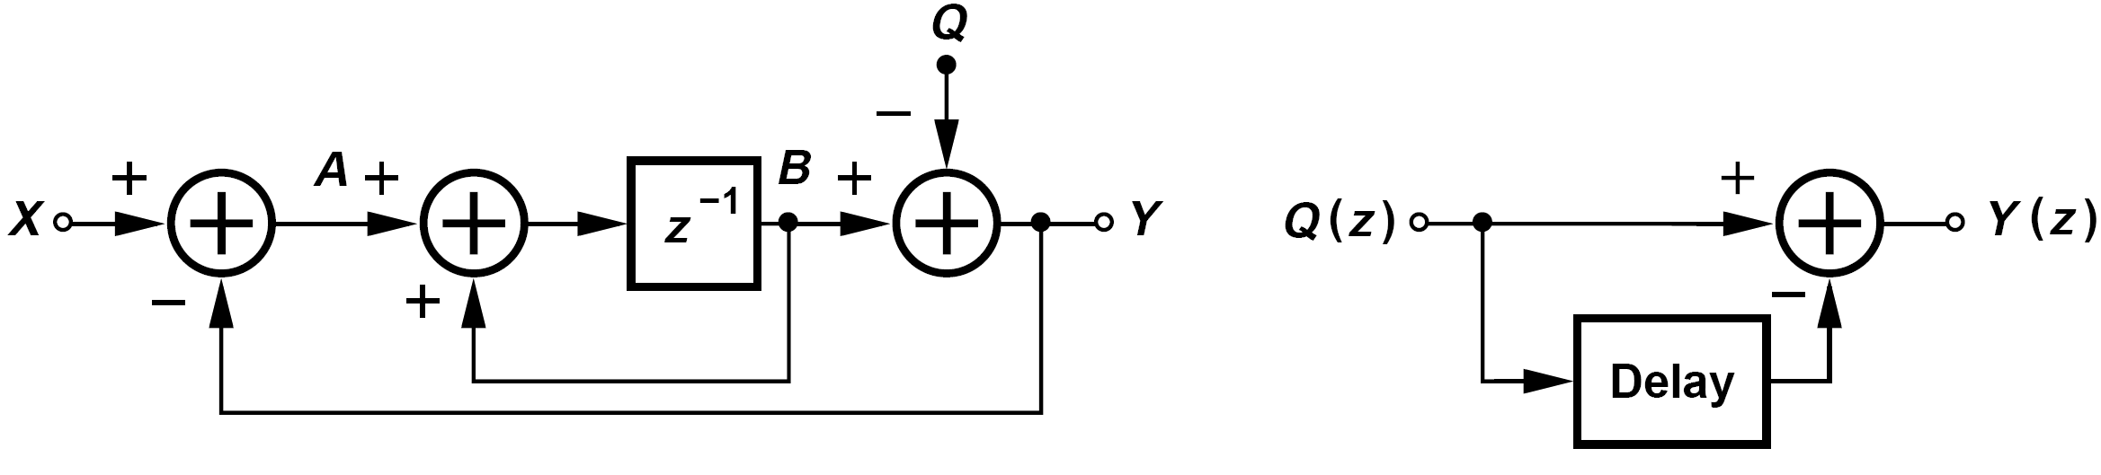
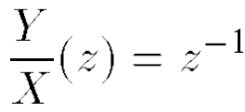
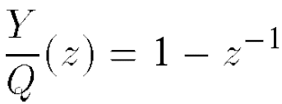
Example of a Discrete-Time Version of Previous System (Ⅱ)
Construct a discrete-time version of the system shown in the previous slide if H must operate as an integrator
Thus, the discrete-time version of the system appears as shown above. Here, if Q = 0, then
i.e., the output simply tracks the input with a delay. Also, if X = 0, then
This is a high-pass response (that of a differentiator) because subtracting the delayed version of a signal from the signal yields a small output if the signal does not change significantly during the delay.

Slide 15
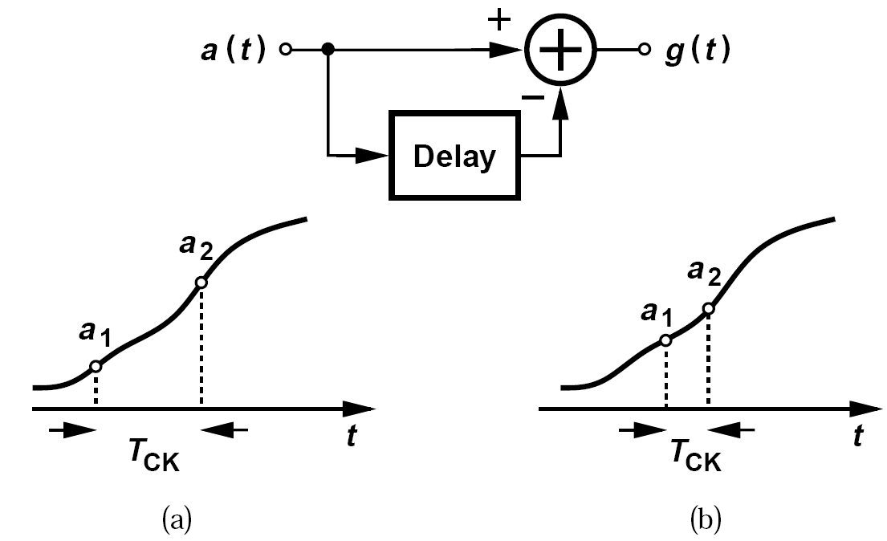
Addition of a Signal and Its Delayed Version for High and Low Clock Frequencies
High clock frequencies low clock frequencies
If the clock frequency increases, a(t) finds less time to change, and a₁ and a₂ exhibit a small difference.

Slide 16
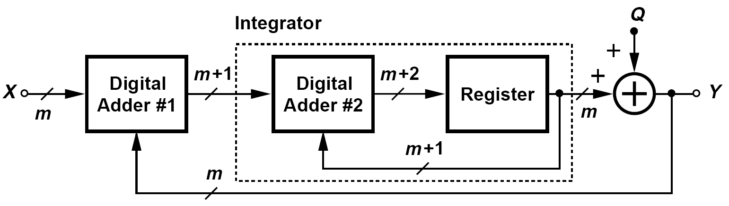
Example of Feedback System with an m-bit Input
Construct the system in the previous example in the digital domain with a precision (word length) of m bits.
Shown here, the system incorporates an input adder (#1) (in fact a subtractor) and
an integrator (“accumulator”) consisting of a digital adder (#2) and a register (delay element). The first adder receives two m-bit inputs, producing an (m + 1)-bit output. Similarly, the integrator produces an (m + 2)-bit output. Since the feedback path from Y drops the two least significant bits of the integrator output, we say it introduces quantization noise, which is modeled by an additive term, Q.
In analogy with the continuous-time version, we note that the high integrator gain forces Y to be equal to X at low frequencies, i.e., the average of Y is equal to the average of X.

Slide 17
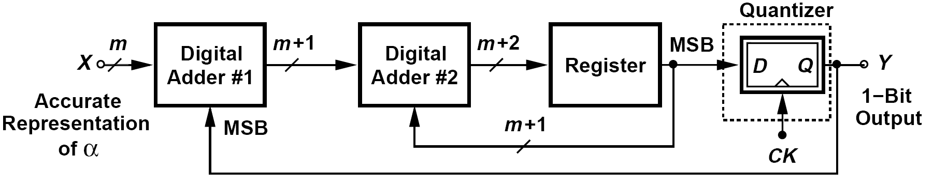
Σ-Δ Modulator
The quantization from m+2 bits to 1 bit introduces significant noise, but the feedback loop shapes this noise in proportion to 1-z-1. The higher integrator gain ensures that the average of the output is equal to X.
The choice of m is given by the accuracy with which the synthesizer output frequency must be defined.

Slide 18
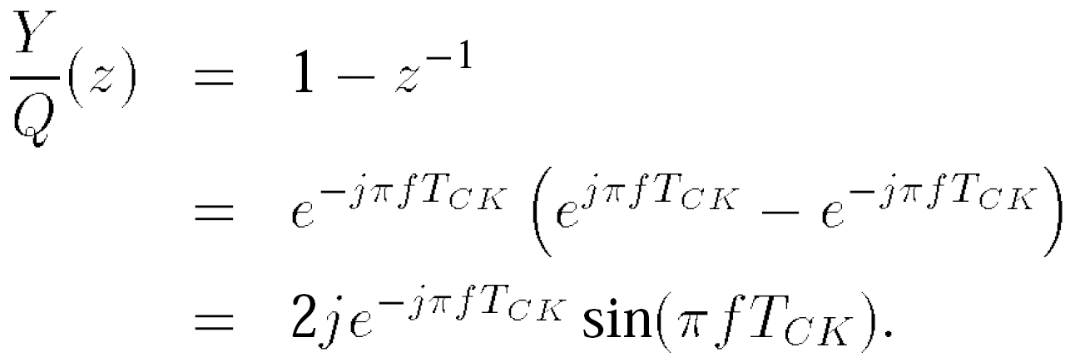
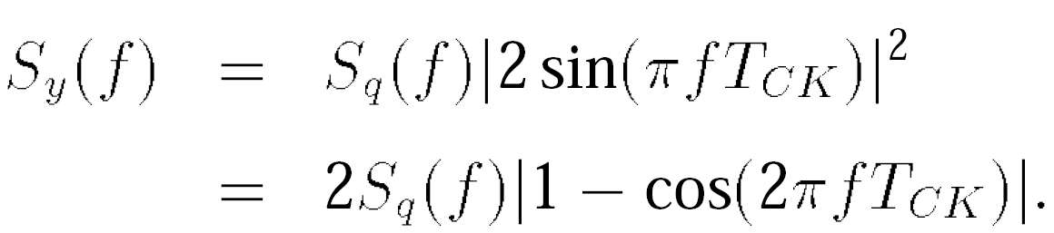
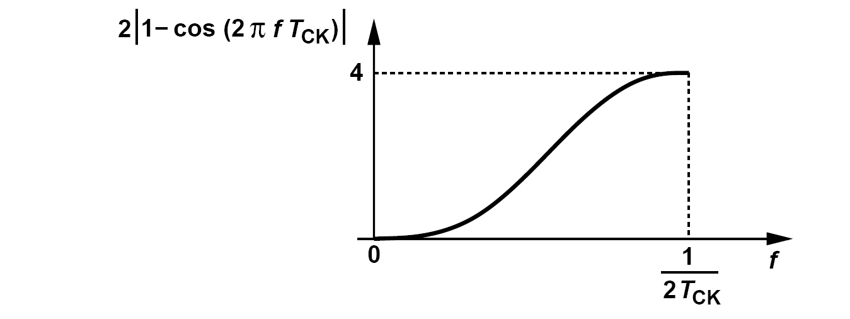
Noise Shaping of Modulator
The noise shaping function begins from zero at f = 0 and climbs to 4 at f = (2T_{CK})-1 (half the clock frequency).
A higher clock rate expands the function horizontally, thus reducing the noise density at low frequencies.

Slide 19
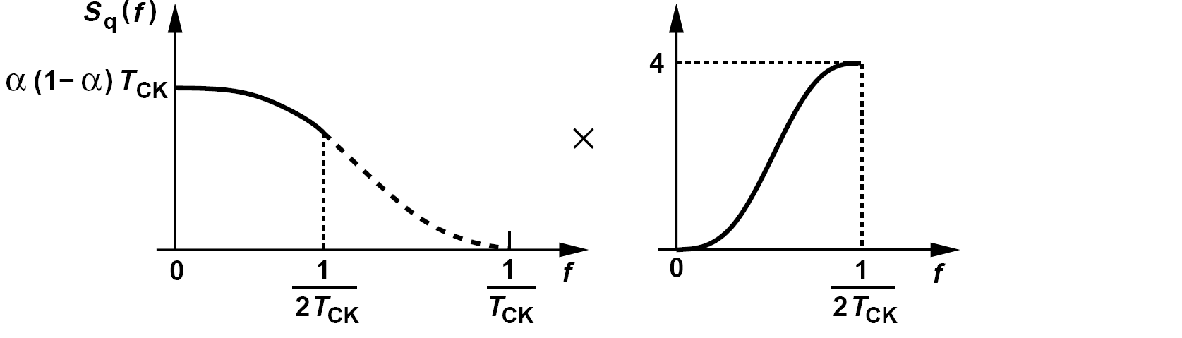
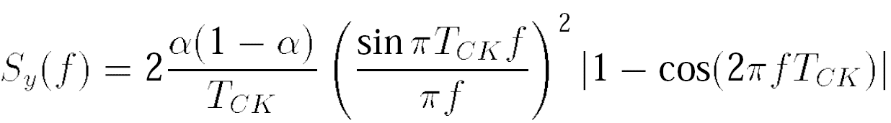
Shape of S_{y}(f)
Since the PLL bandwidth is much smaller than f_{REF}, we can consider S_{q}(f) relatively flat for the frequency range of interest. We hereafter assume that the shape of S_{y}(f) is approximately the same as that of the noise-shaping function.

Slide 20
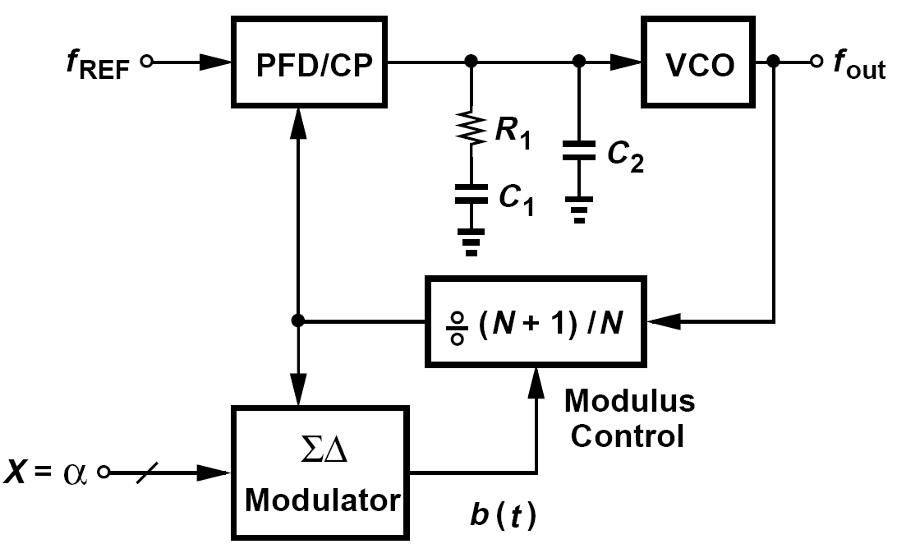
Summary: Fractional-N Synthesizer Developed Thus Far
Shown above is a basic fractional-N loop using a Σ-Δ modulator to randomize the divide ratio.
Clocked by the feedback signal, the Σ-Δ modulator toggles the divide ratio between N and N+1 so that the average is equal to N+α

Slide 21
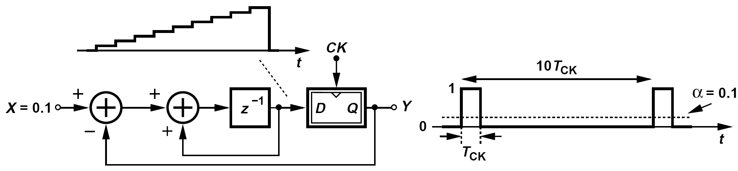
Problem of Tones
The output spectrum of Σ-Δ modulators contains the shaped noise, but also discrete tones. If lying at low frequencies, such tones are not removed by the PLL, thereby corrupting the synthesizer output.
To suppress these tones, the periodicity of the system must be broken. If the LSB of X randomly toggles between 0 and 1, then the pulses in the output waveform occur randomly, yielding a spectrum with relatively small tones.

Slide 22
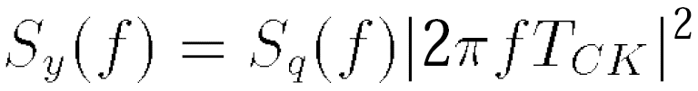
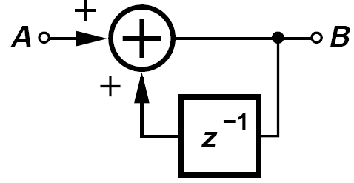
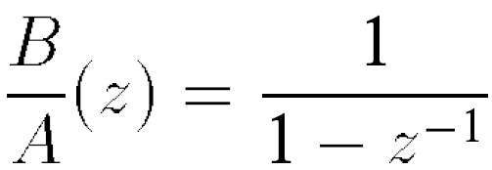
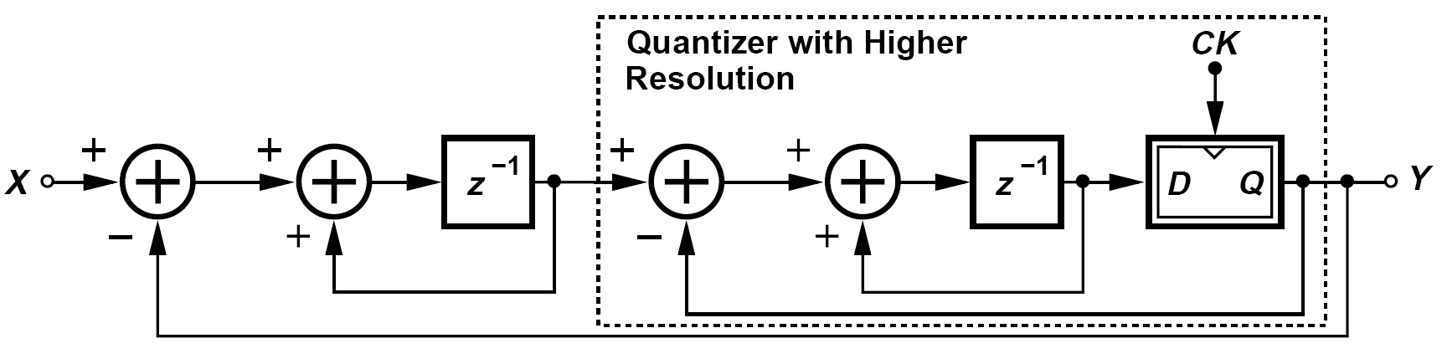
Seeking a System with a Higher-Order Noise Shaping
The noise shaping function shown above does not adequately suppress the in-band noise. This can be seen by noting that, for f << (πT_{CK})-1,
We therefore seek a system that exhibits a sharper roll-off.
The following development will call for a “non-delaying integrator”.
The transfer function is given by
Replace the 1-bit quantizer with a Σ-Δ modulator

Slide 23
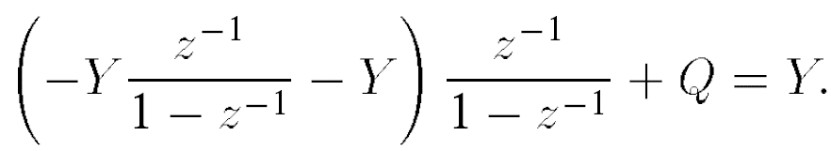
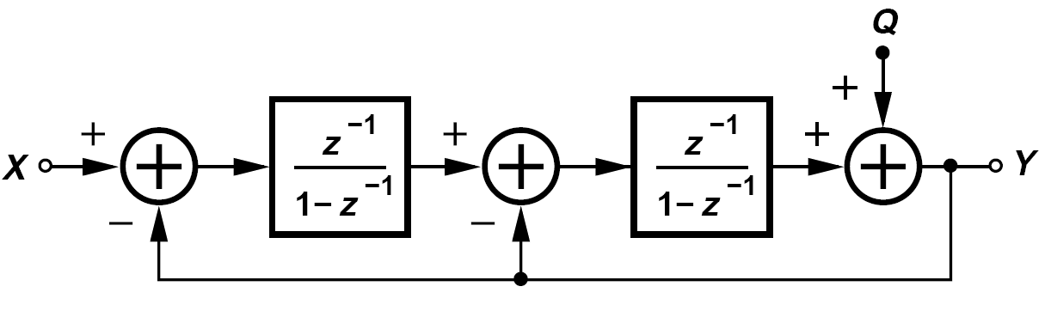
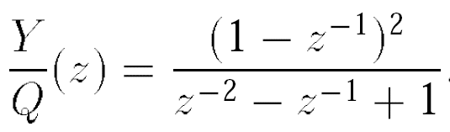
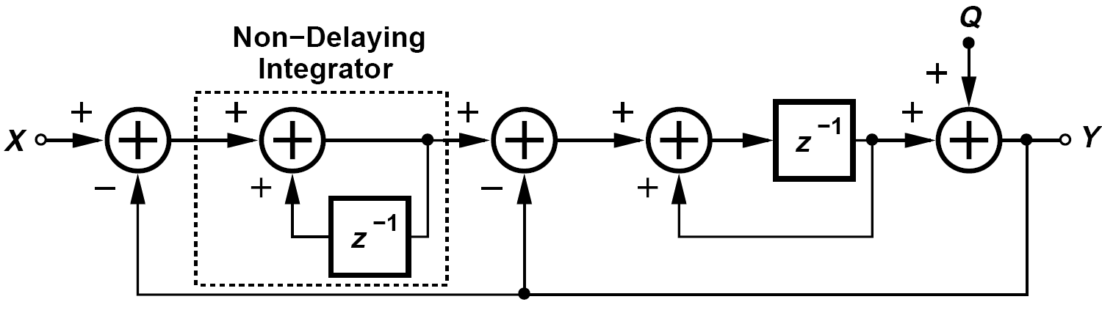
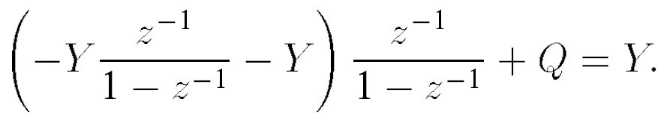
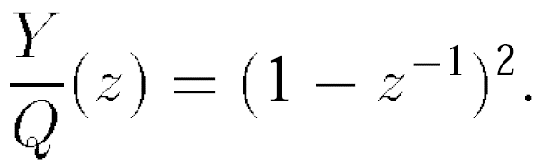
To Determine the Noise Shaping Function
Modifying the first integrator to a non-delaying topology:

Slide 24
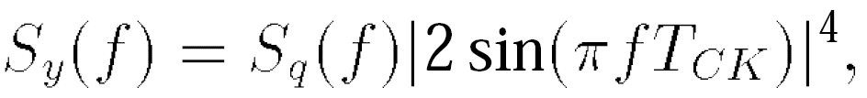
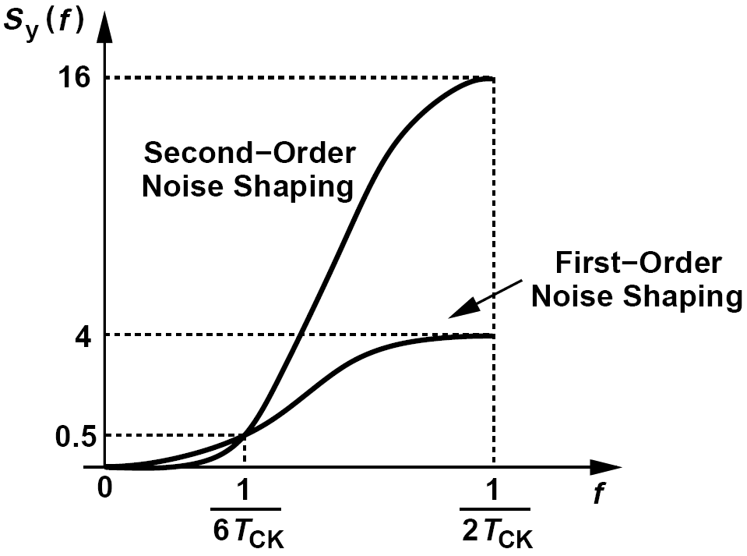
Comparison: Noise Shaping in First- and Second-Order Modulators
We have
The noise shaping in second-order modulator remains lower than that of the first-order modulator for frequencies up to (6T_{CK})-1

Slide 25

Cascaded Modulators
Y₂ is a relatively accurate replica of U. Y₂ is combined with Y₁, yielding Y_{out} as a more accurate representation of X. The system is called a “1-1 cascade”.

Slide 26



Residual Quantization Noise
we have
and

Slide 27

Example of Signal Combining Operation
Construct a circuit that performs the combining operation shown previously.
Solution:
For 1-bit streams, multiplication by z -1 is realized by a flipflop. The circuit thus appears as shown below:

Slide 28





Problem of Out-of-Band Noise
The transfer function from the quantization noise to the frequency noise
the phase noise
The spectrum of the phase noise is thus obtained as
Experiencing the low-pass transfer function

Slide 29

Summary: Effects of Phase Noise at the Output of a
Fractional-N Loop
For small value of f, the product, S_{out}(f), begins from zero and rises to some extent.
For larger values of f, the f2 behavior of the noise shaping function cancels the roll-off of the PLL, leading to a relatively constant plateau.
At values of f approaching 1/(2T_{CK}) = f_{REF} /2, the product is dominated by the PLL roll-off. If comparable with the shaped VCO phase noise, this peaking proves troublesome.

Slide 30



Effect of Charge Pump Mismatch
(a) PFD/CP with current mismatches. (b) effect for Up ahead of Down. (c) effect for Up behind Down. (d) resulting characteristic
the total charge delivered to the loop filter is equal to
Now, let us reverse the polarity of the input phase difference.

Slide 31


Example of Charge Pump Mismatch in Integer-N Synthesizers
Does the above nonlinearity manifest itself in integer-N synthesizers?
No, it does not. Recall from Chapter 9 that, in the presence of a mismatch between I₁ and I₂, an integer-N PLL locks with a static phase offset, ΔT₀, such that the net charge injected into the loop filter is zero. Now suppose the divider output phase experiences a small positive instantaneous jump (e.g., due to the VCO phase noise).
The net charge therefore becomes proportionally positive. Similarly, for a small negative instantaneous phase jump, the net charge becomes proportionally negative. The key point is that, in both cases, the charge is proportional to I₁, leading to the characteristic shown in (d).

Slide 32


What is the Effect of the Above Nonlinearity on a ΣΔ Fractional-N Synthesizer?
Decompose the characteristic shown in previous example into two components:
We roughly approximate the error by a parabola, αΔT2_{in} – b, and write Q_{tot} ≈ I_{avg}ΔT_{in}+ αΔT2_{in}-b
The multiplication of ΔT_{in} by itself is a mixing effect and translates to the convolution.
Charge pump nonlinearity translates the ΣΔ modulator’s high-frequency quantization noise to in-band noise, thus modulating VCO.

Slide 33



Approach to Alleviating the Charge Pump Mismatch
Split the PFD reset pulse to create a static phase error and avoid slope change.
The PLL must lock with a zero net charge
The static phase offset is
For a sufficiently large T_{D} and hence ΔT₀, phase fluctuations simply modulate the width of the negative current pulse in I_{net}, leading to a characteristic with a slope of I₂. Unfortunately, this technique also introduces significant ripple on the control voltage.

Slide 34

Another Approach Using Sampling Circuit
A sampling circuit interposed between the charge pump and the loop filter can “mask” the ripple, ensuring that the oscillator control line sees only the settled voltage produced by the CP.
In other words, a deliberate current offset or Up/Down misalignment along with a sampling circuit removes the nonlinearity resulting from the charge pump and yields a small ripple

Slide 35


Quantization Noise Reduction Techniques: DAC Feedforward
quantization error:
Here, W is the shaped noise whereas in cascaded modulators, we compute Q = Y-A, which is unshaped.

Slide 36

Basic DAC Feedforward Cancellation
In the absence of analog and timing mismatches, each ΣΔ modulator output pulse traveling through the divider, the PFD, and the charge pump is met by another pulse produced by the DAC, facing perfect cancellation.

Slide 37


Issues in Previous System and Modifications(Ⅰ)
An integrator must be interposed between the subtractor and the DAC due to different form of quantization noise arriving at the loop filter and DAC output.
Accuracy requirement: it is necessary to “requantize” the 17-bit representation by another ΣΔ modulator, thereby generating a, say, 6-bit representation whose quantization noise is shaped.

Slide 38

Issues in Previous System and Modifications(Ⅱ)
quantization error:
The Up and Down pulses activate the CP for only a fraction of the reference period, producing a current pulse of constant height each time. The DAC, on the other hand, generates current pulses of constant width.
The sampling loop filter is typically used to mask the ripple.
What is the effect of the mismatch between the charge pump current and
the DAC current in system above?
The unequal areas of the current pulses generated by the CP and the DAC lead to incomplete cancellation of the quantization noise. For example, a 5% mismatch limits the noise reduction to roughly 26 dB.

Slide 39



DAC Gain Error
Since both the charge pump current and the DAC current are defined by means of current mirrors, mismatches between these mirrors lead to incomplete cancellation of the quantization noise.
The quantization noise applied to the DAC are convolved and folded to low frequencies, raising the in-band phase noise.

Slide 40


Fractional Divider
Another approach to reducing the ΣΔ modulator quantization noise employs “fractional” dividers, i.e., circuits that can divide the input frequency by noninteger values such as 1.5 or 2.5
Even with a half-rate clock, D_{out} track D_{in}. In other words, for a given clock rate, the input data to a DET flipflop can be twice as fast as that applied to a single-edge-triggered counterpart.

Slide 41


CML Implementation and Use in Divide-by-1.5 Circuit
CML implementation
Replacing the flipflops of ÷3 circuit with the DET circuit. The circuit produces one output period for every 1.5 input periods.

Slide 42

Reference Doubling
If the reference frequency can be doubled by means of an on-chip circuit preceding the PLL, then the phase noise due to the ΣΔ modulator quantization can be reduced by 6 dB.
The input is delayed and XORed with itself, producing an output pulse each time V_{in}(t) and
V_{in} (t-ΔT) are unequal.

Slide 43

Example of Fourier Series of Doubler Output
If we consider V_{out}(t) as the sum of the two half-rate waveforms, determine the
Fourier series of V_{out}(t).
The Fourier series of V₁(t) can be written as
where ω₀ = 2π/(2T₁). The second waveform, V2(t), is obtained by shifting V₁ by T₁. Thus, the
first harmonic is shifted by ω₀T₁ = π, the second by 2ω₀T₁ = 2π, etc. It follows that
Adding V₁(t) and V₂(t), we note that all odd harmonics of ω₀ vanish, yielding a waveform
with a fundamental frequency of 2ω₀

Slide 44

Doubler Output with Input Duty Cycle Distortion
If the input duty cycle deviates from 50%, the odd harmonics are not completely canceled, appearing as sidebands around the main component at 1/T₁. Since the PLL bandwidth is chosen about one-tenth 1/T₁, the sidebands are attenuated to some extent.

Slide 45



Multi-Phase Frequency Division: an Overview
It is possible to create a fractional divide ratio by means of a multi-phase VCO and a multiplexer. Suppose a VCO generates M output phases with a minimum spacing of 2π/M, and the MUX selects one phase each time, producing an output given by
where k is an integer. Now, let us assume that k varies linearly with time, sequencing through 0, 1, · · ·, M -1, M, M + 1, · · · . Thus, k = βt, where β denotes the rate of change of k, and hence
The divide ratio is therefore equal to 1 - (β/ω_{c})(2π/M)

Slide 46

An Example of Multi-Phase Frequency Division
This technique affords a frequency divider having a modulus of 1 and modulus of 1.25. Since the divide ratio can be adjusted in a step of 0.25, the quantization noise falls by 20 log 4 = 12 dB

Slide 47

Issues in Multi-Phase Fractional Division: Problem of Phase Selection Timing Margin
The MUX select command (which determines the phase added to the carrier each time) is difficult to generate.
The edges of the select waveforms have a small margin with respect to the input edges. Moreover, if the divide ratio must switch from 1.25 to 1, a different set of select waveforms must be applied, complicating the generation and routing of the select logic.

Slide 48


Issues in Multi-Phase Fractional Division: Phase Mismatches
The quadrature LO phases and the paths within the MUX suffer from mismatches, thereby displacing the output transitions from their ideal points in time.
The spectrum contains a large component at 4/(5T_{in}) and “sidebands” at other integer multiples of 1/(5T_{in})
It is possible to randomize the selection of the phases so as to convert the sidebands to noise.

Slide 49





Appendix I: Spectrum of Quantization Noise
In general, if a pulse p(t) is randomly repeated every T_{b} seconds,
the resulting spectrum is given by
The variance of a random variable x is obtained as
Probability density function of binary
data with an average value of α
Fourier transform of p(t) is equal to

Slide 50





References (Ⅰ)

Slide 51

References (Ⅱ)

